Slide 1
Robotic handling a tube tester

Slide 2
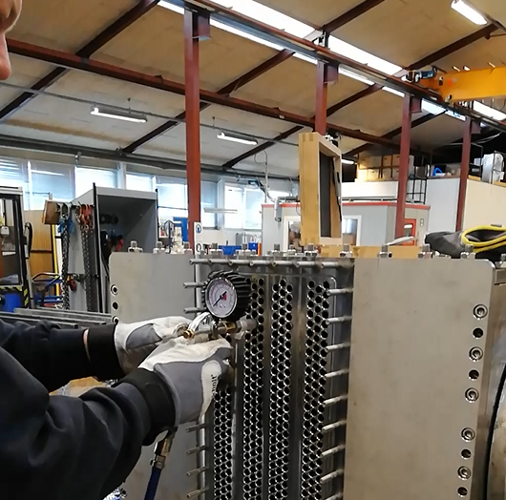
Background and motivation
How it is done now:
Need of operator
Repetitive
Prone to error
Hard to standardize

Slide 3
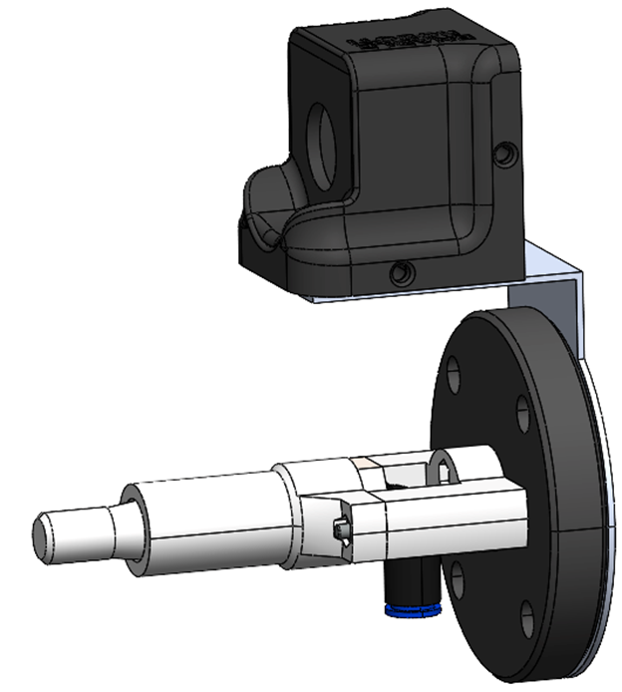

Problem definition
Movement of the robot
- Definition of the test procedure
- Design of the gripper
Pressure test
Tube tester
Camera

Slide 4
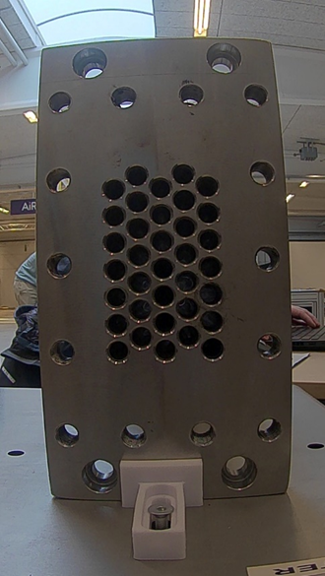
Problem definition
- Store results of the automated process
- Implementation of visual recognition
- Collection into one program

Slide 5
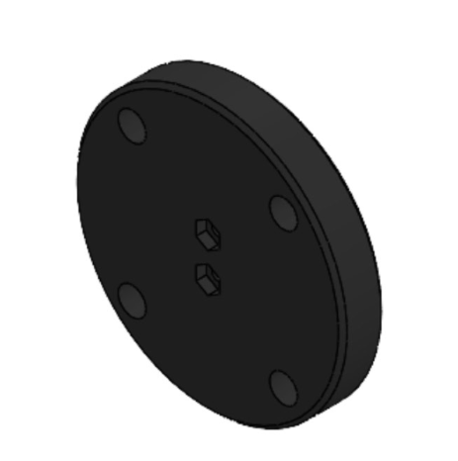
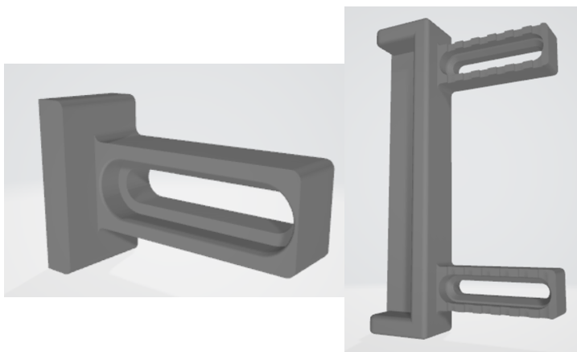
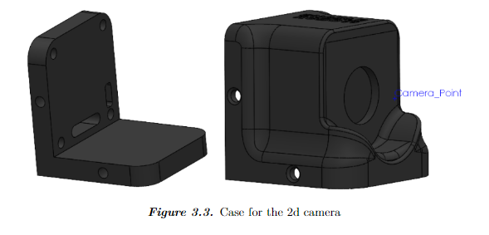
Concept design
Simple design:
Adaptor
Camera
Blocks

Slide 6
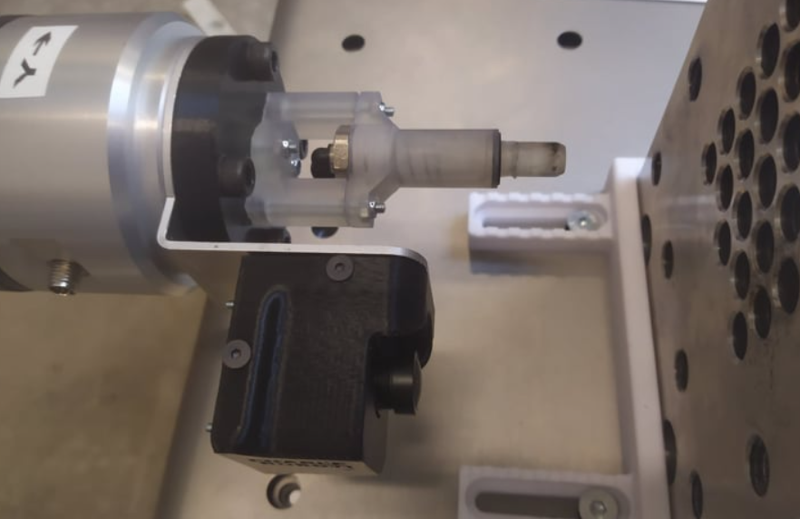
Concept Design

Slide 7
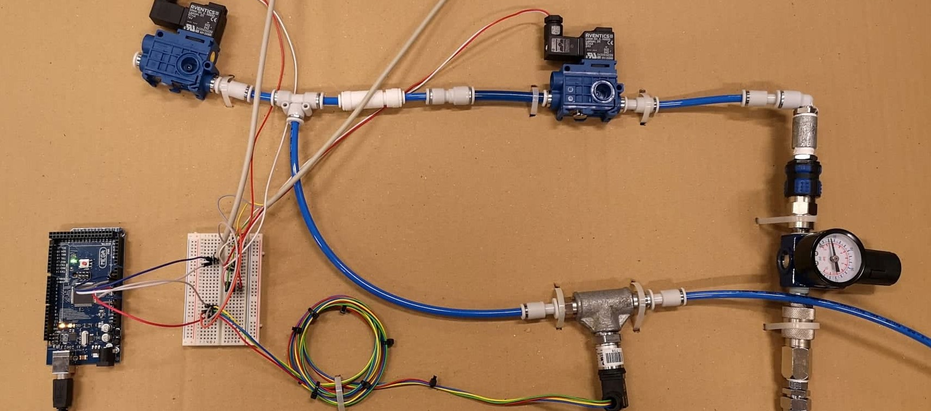
pneumatic system

Slide 8
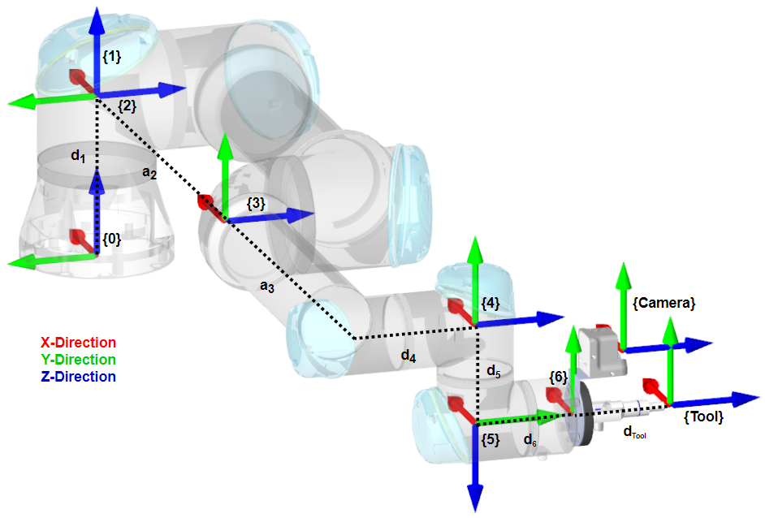
Frame attachments
-Forward Kinematics
-Inverse Kinematics
-Dynamics

Slide 9
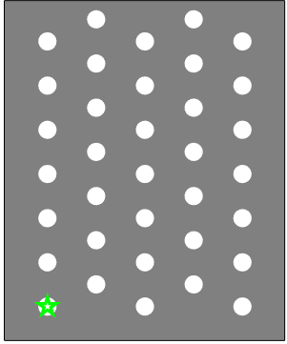
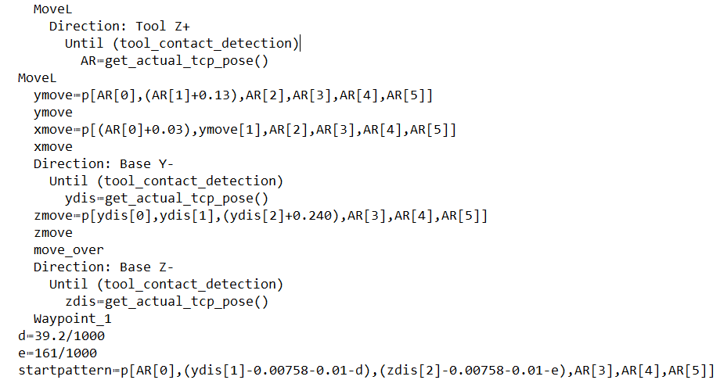
Program
Polyscope for movement and valve control
Automatically find the cooler

Slide 10
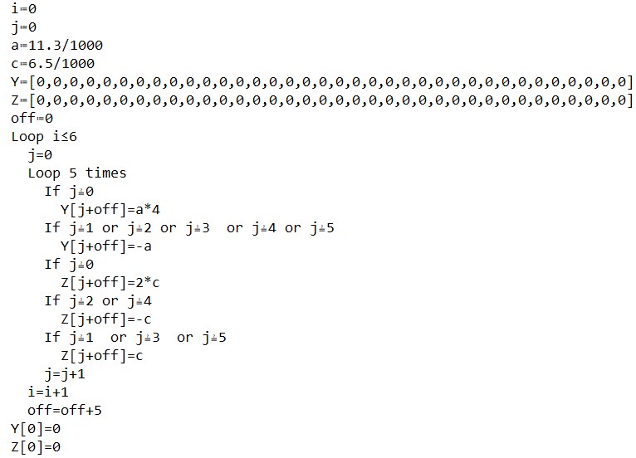
Program
Make vector with coordinates for hole pattern

Slide 11
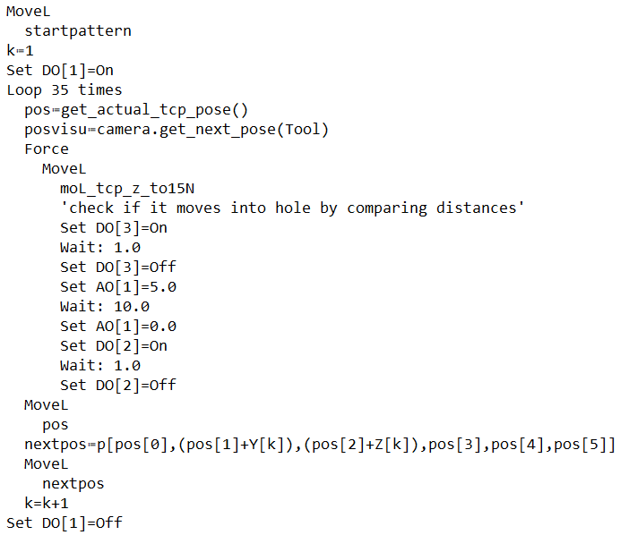
Program
Force mode and pressure test

Slide 12
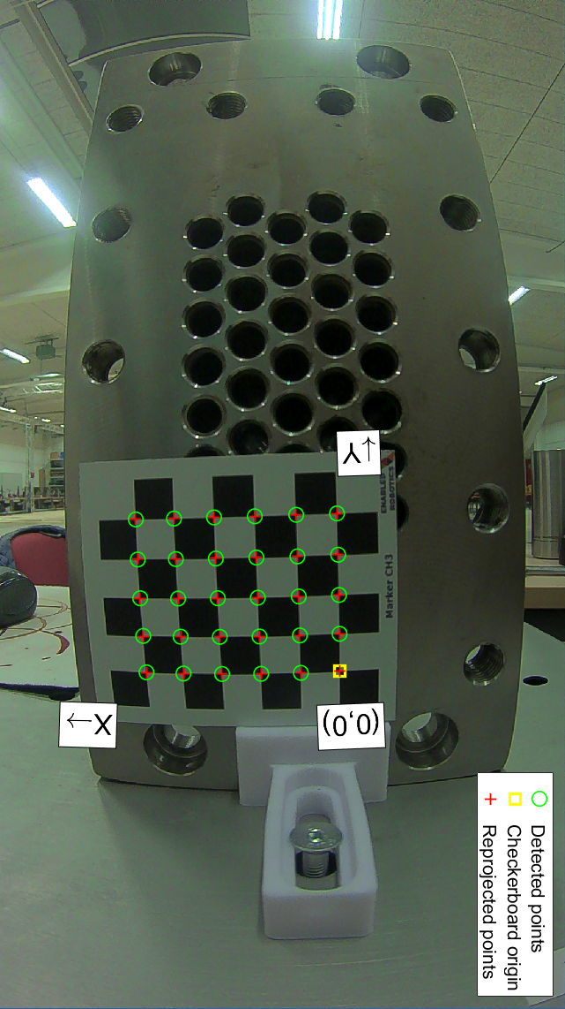
Computer vision
First step - Camera calibration
- Checkerboard
- Matlab or Python
- Multiple images

Slide 13
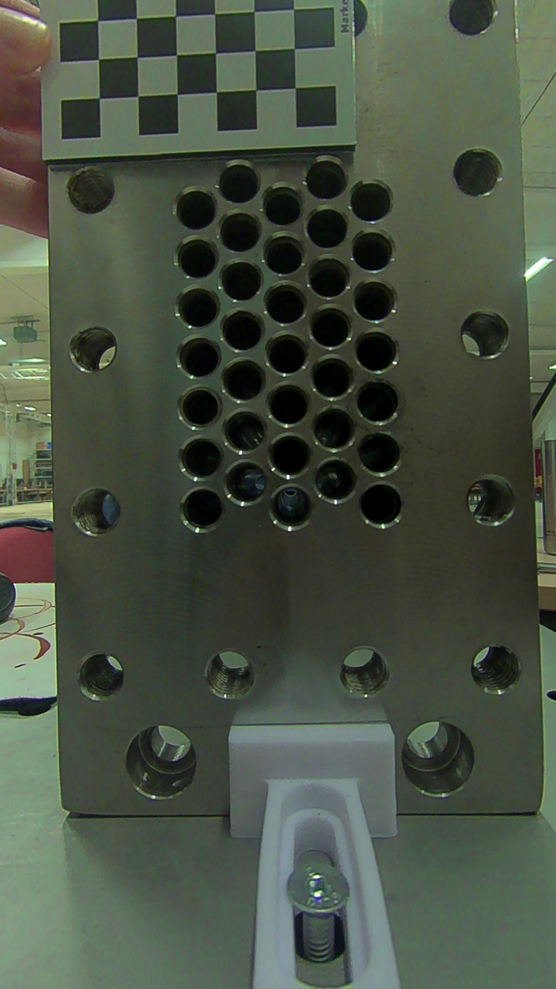
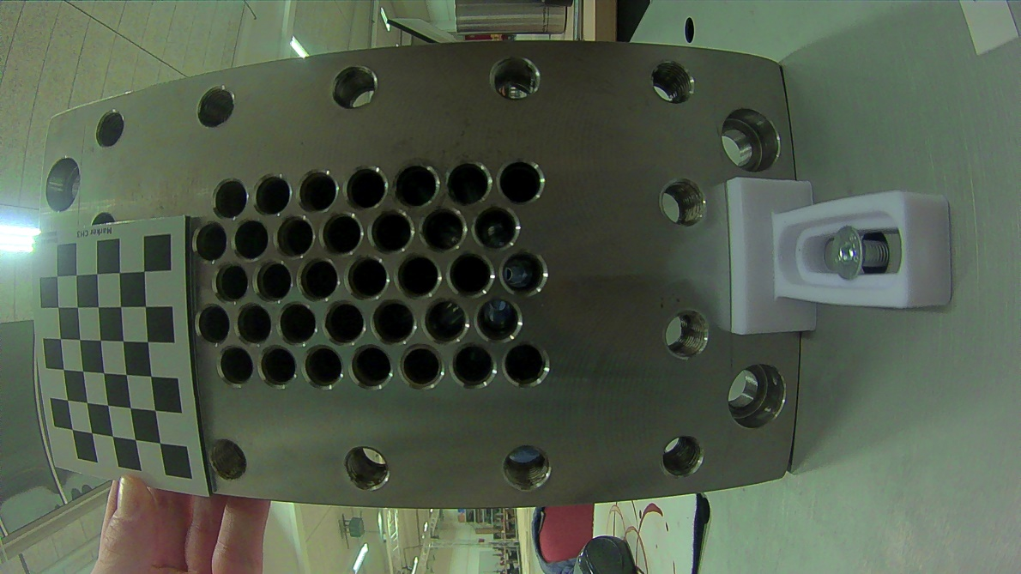
Computer vision

Slide 14
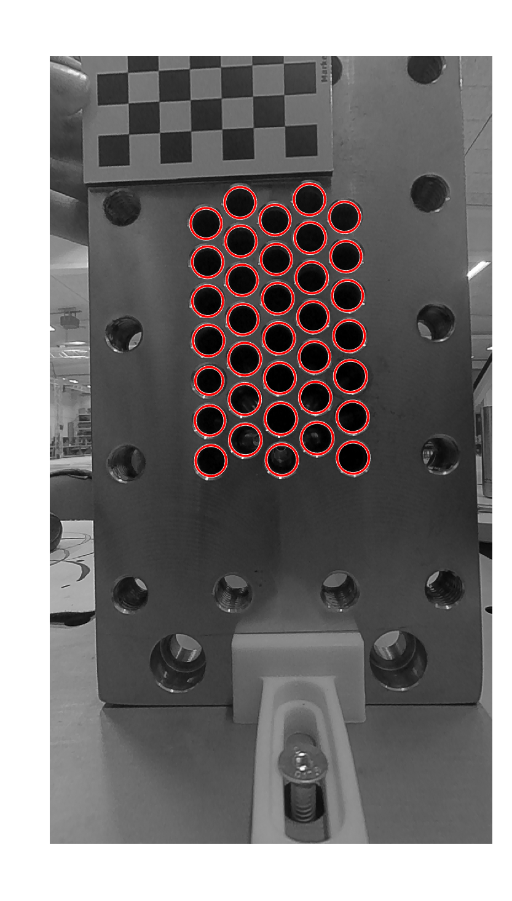
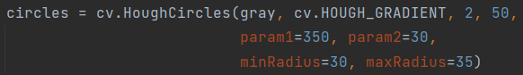
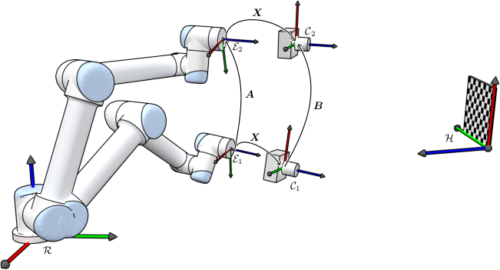
Computer vision
Hole detection
Matlab: [center, radii] = imfindcircles(gray_image,[26 43],'ObjectPolarity','dark',’S ensitivity’ ,0.9275);
Python:
Hand eye calibration

Slide 15
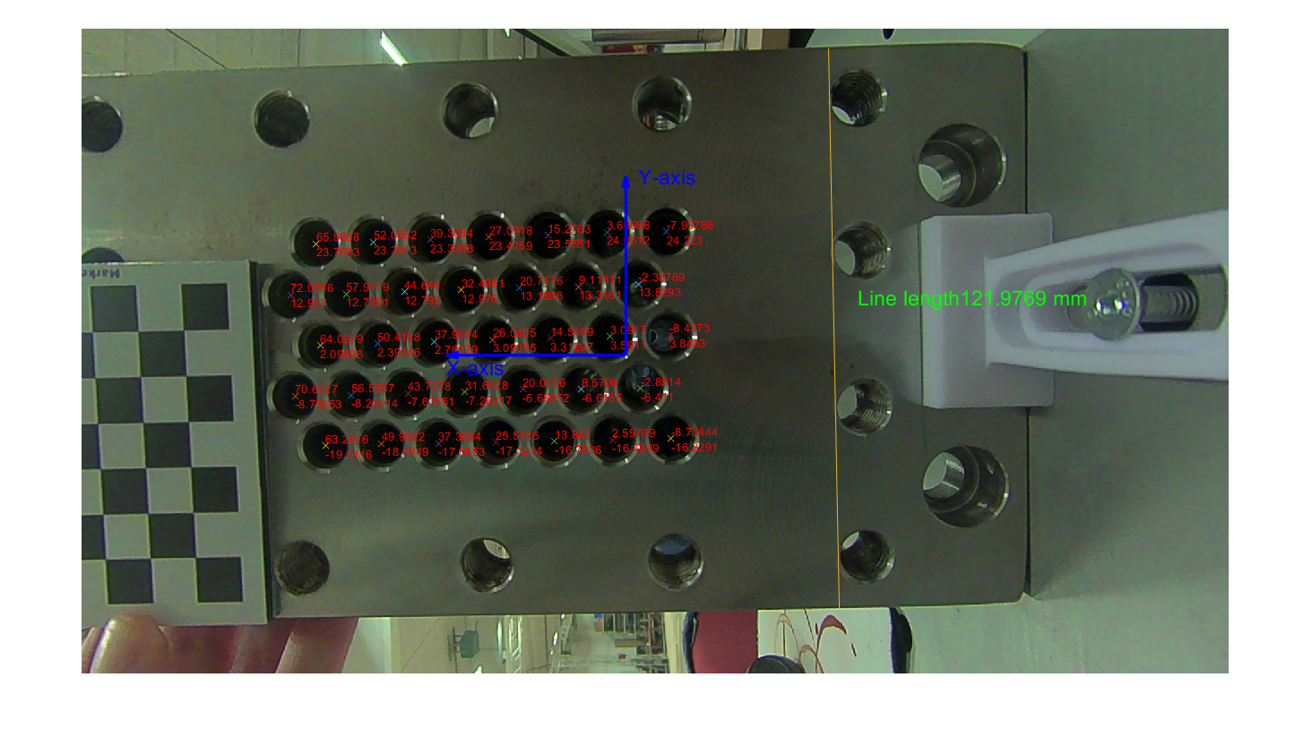
Computer vision
Calculate XY
- Measure the depth
Transformation matrix and rotation handeyecalibration and forward kinematics

Slide 16
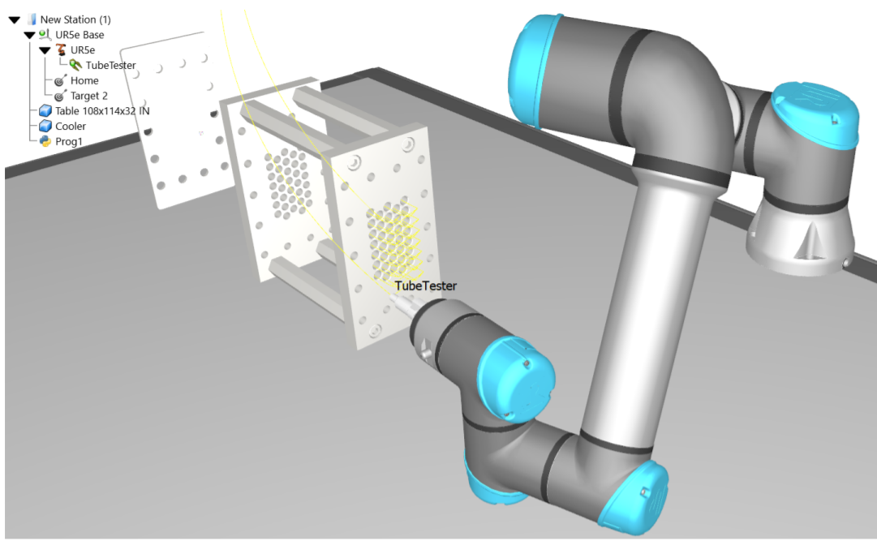
Simulation In Robo DK

Slide 17
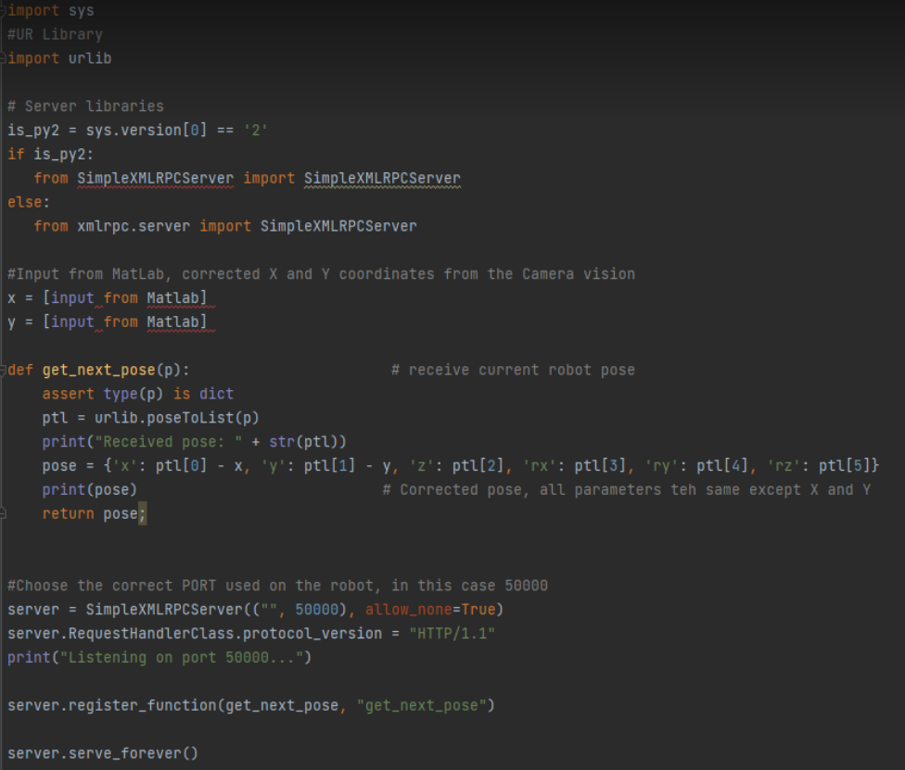
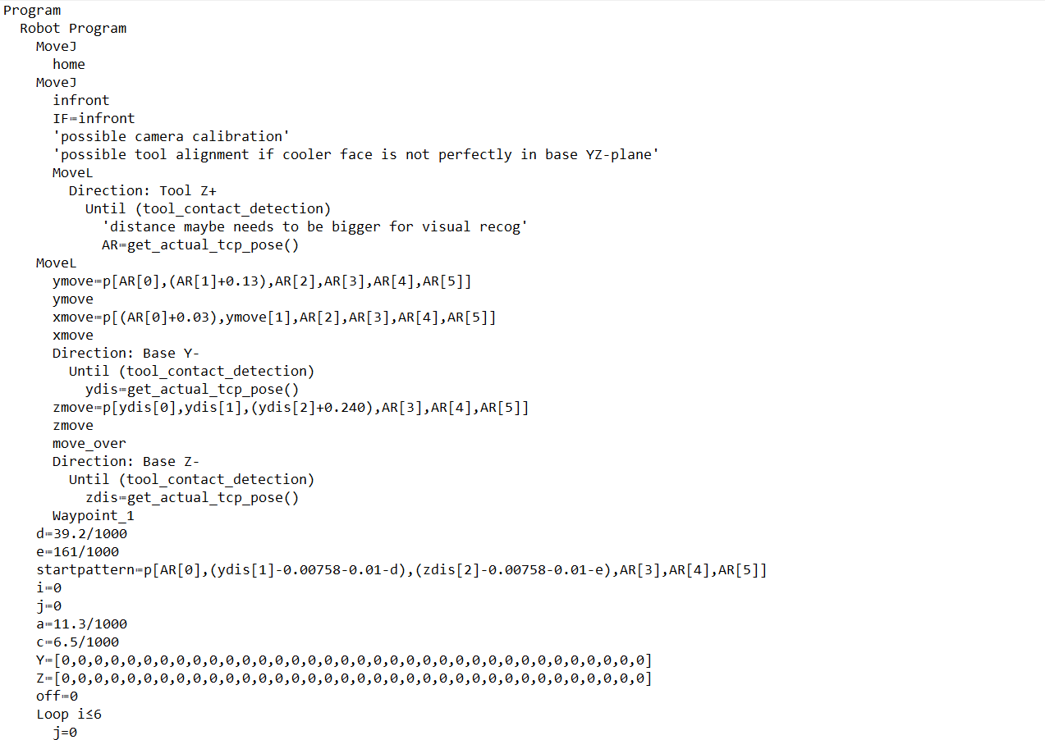
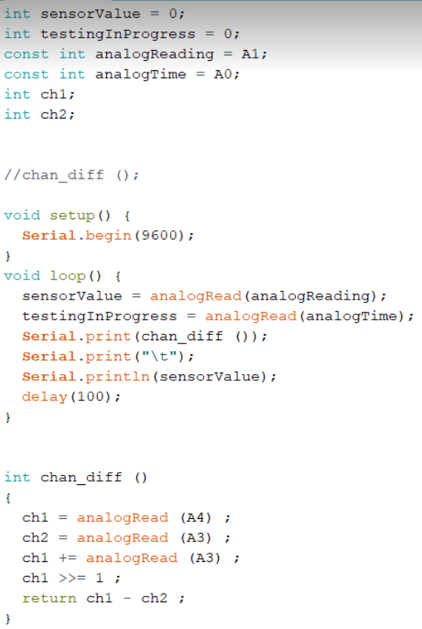
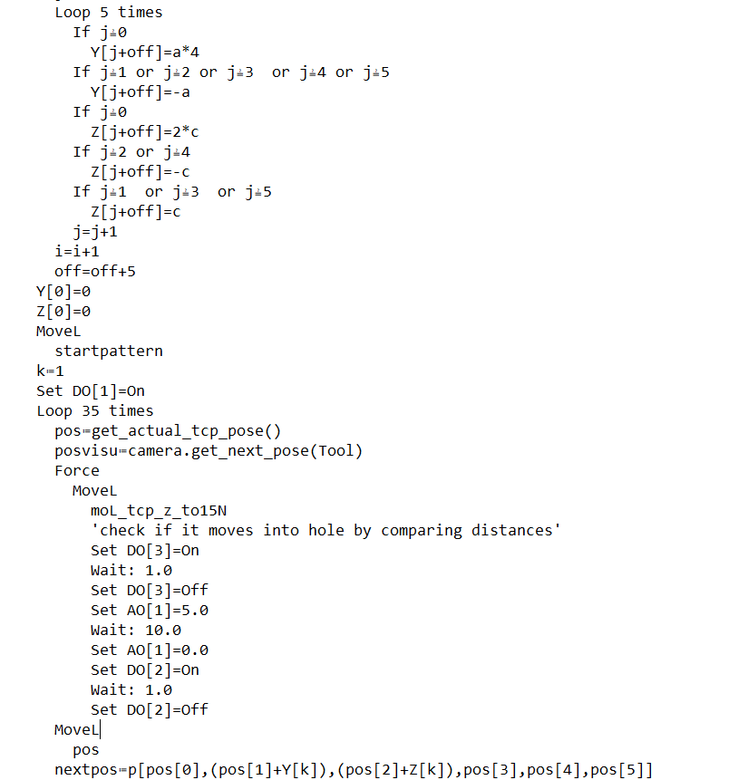
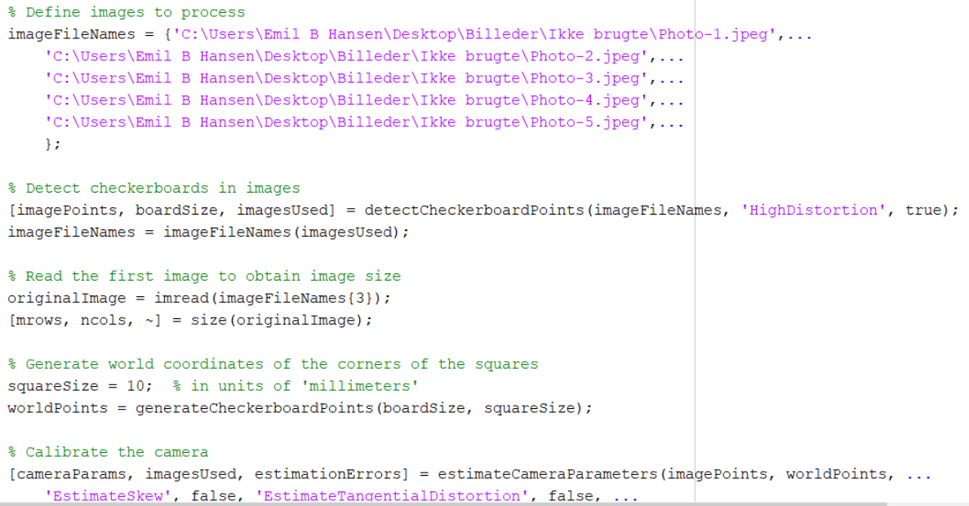
Discussion and Future Work
Collecting everything in one program
Limit test the visual recognition
Optimize movement and test procedure for speed

